Slide 1

Project 1
Chicago taxi trips EDA
汽
车
设
Yingyi Luo yluo52@uic.edu
Haoxuan Zeng hzeng20@uic.edu

Slide 2

Data Sets and prepossessing
01
Exploratory Data Anlysis(EDA)
02

Slide 3
01
Data Sets and prepossessing

Slide 4
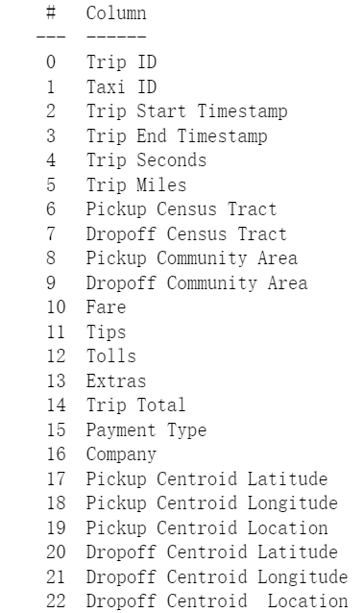
200
million
2.32 million
We obtained our data from a website called data, city of Chicago, focusing on Taxi Trips. This database contains 200 million pieces of records, with a lot of information included such as time stamp, pick up and drop off area, tolls and tips, ext. In our project, we picked up 2.32 million pieces of records as our dataset and we divided the dataset to 2 parts regarding the seasons, summer and winter. The summer dataset contains data from June 1st to Sept 30 in 2021, while the winter dataset contains data from Oct 1st to Dec 31. We also obtained the Boundaries/community areas of Chicago and we mainly concentrated on the airport and loop area and use zip code to make a data clip for this specific area.

Slide 5
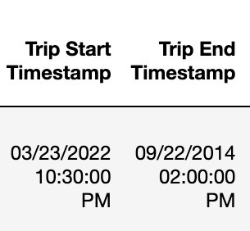


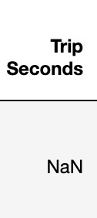
Data cleaning
Trip Timestamp are invaild.
Trip Seconds is NaN.
Trip Seconds is not 0, but Trip Miles is 0.

Slide 6
02
Exploratory Data Anlysis(EDA)
Notes:
Let me introduce our eda parts

Slide 7
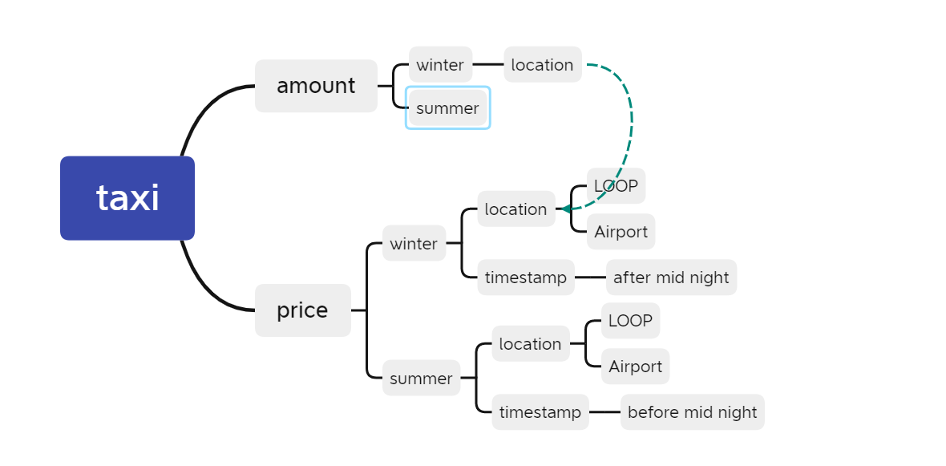
Mind mapping of Chicago taxi analyse
Notes:
Here is the mind mapping through our data analyzing. Firstly, we separate our data into two dimension: the amount and the price. Secondly, we explore our data in different seasons. Lately, we analyze these data in two dimension: the location and the timestamp

Slide 8
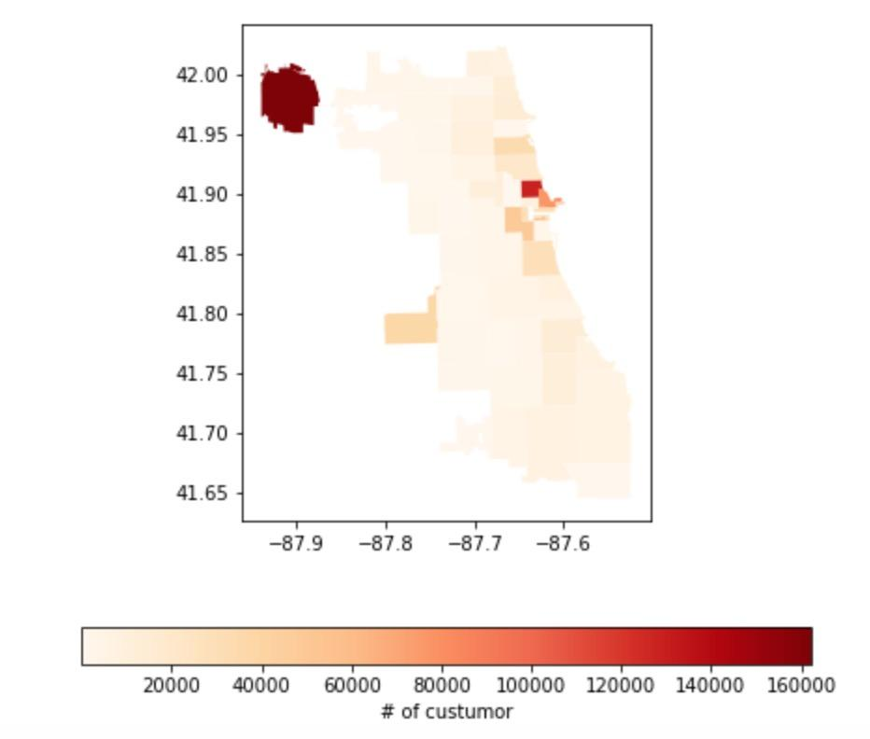
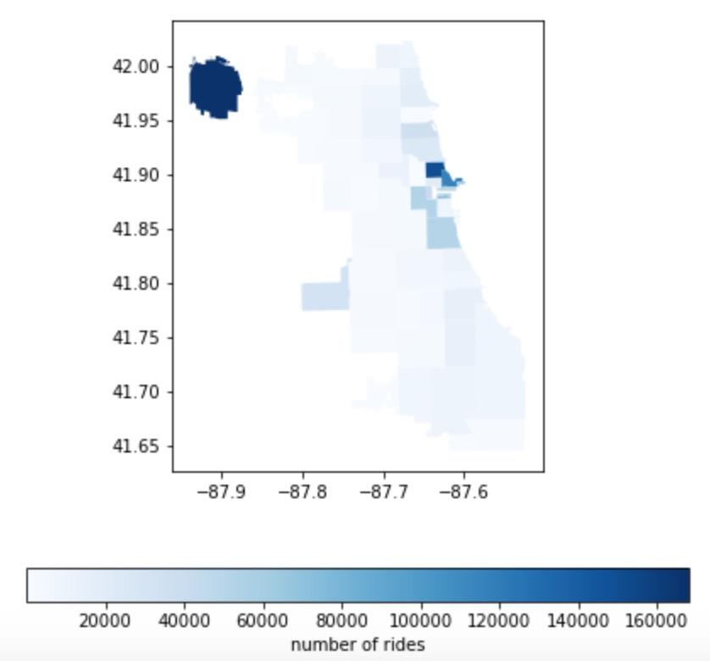
Different numbers in seasons
Firstly, we investigated the number of customers in summer and winter and we found that way more people would take taxi in the winter which might due to the extremely cold weather. Some patterns were witnessed, for example, people traveling from the airport and within the loop area are more likely to call a taxi.
Notes:
Firstly, we investigated the number of customers in summer and winter and we found that way more people would take taxi in the winter which might due to the extremely cold weather. Some patterns were witnessed, for example, people traveling from the airport and within the loop area are more likely to call a taxi.

Slide 9
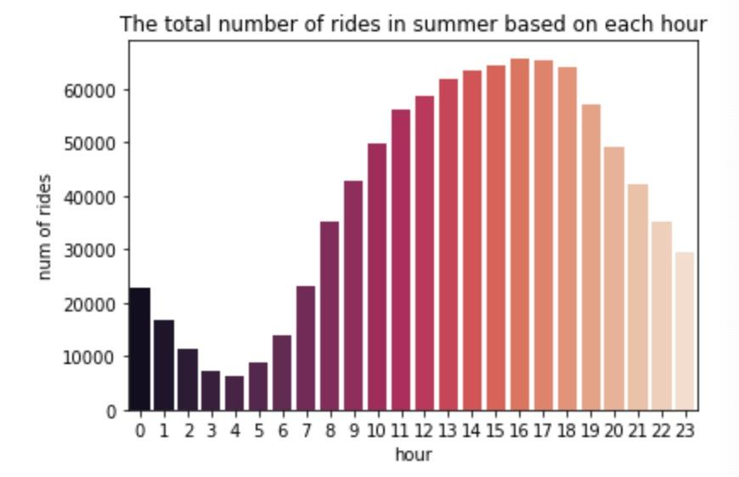
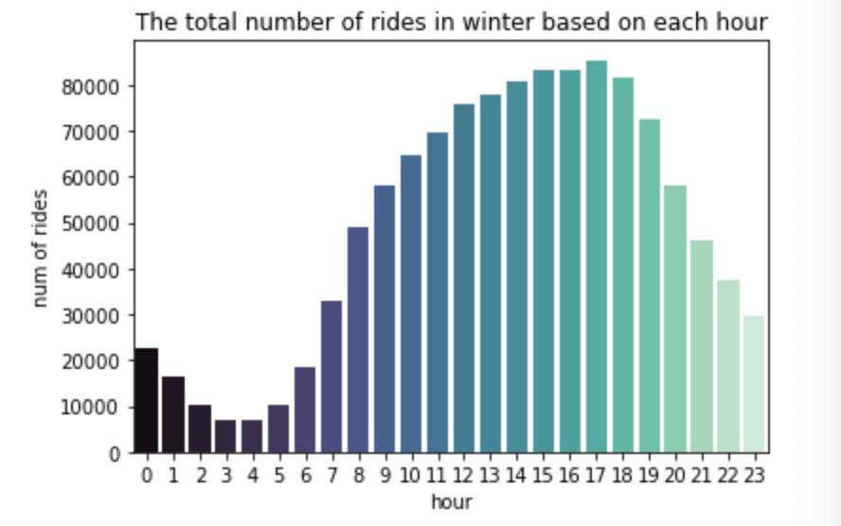
This is the time distribution of riders in summer and winter. The patterns are similar for summer and winter, as you can see, the busy hours in summer and winter are 9am to 11 pm which is very intuitive, but remember the number of total customers was higher in winter comparing to that in the summer.
Notes:
This is the time distribution of riders in summer and winter. The patterns are similar for summer and winter, as you can see, the busy hours in summer and winter are 9am to 11 pm which is very intuitive, but remember the number of total customers was higher in winter comparing to that in the summer.

Slide 10
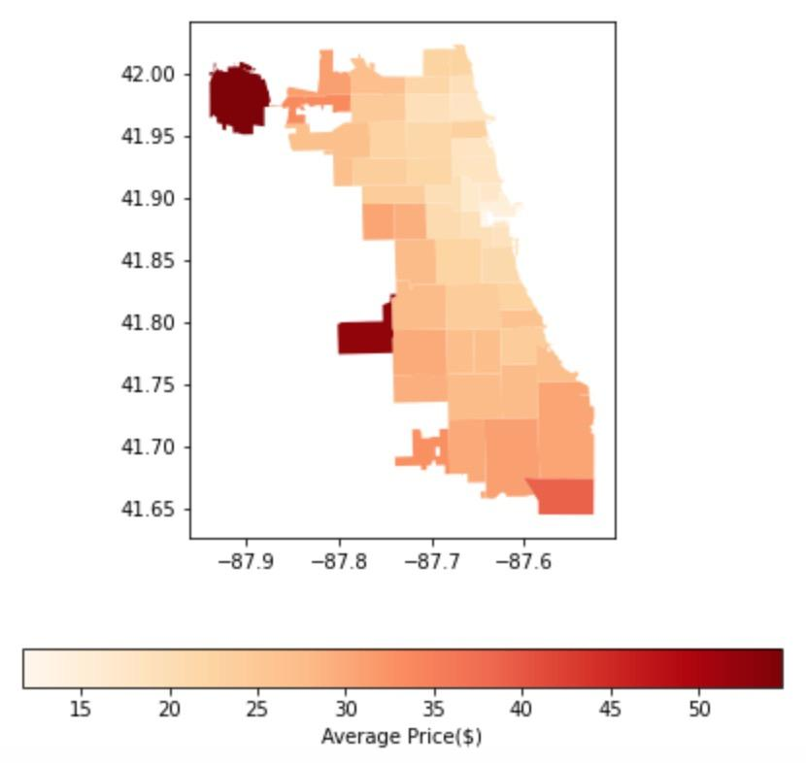
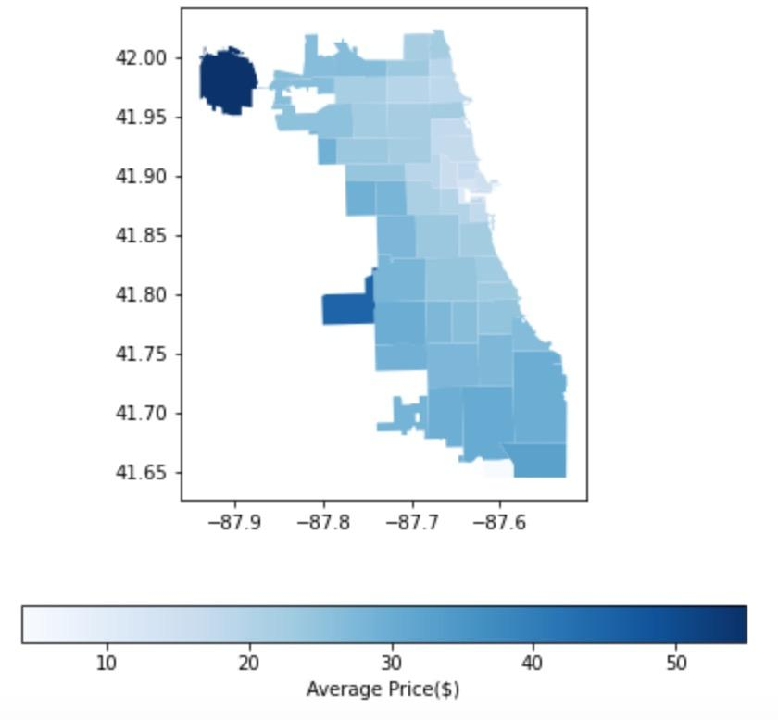
Average price in seasons has no significance
This two panels show the average tolls in summer and winter. The darker the color the higher the price. According to the price range scale and the color distribution, there is no significant difference regarding the price in different seasons, but the price distribution did showed a specific pattern, for example, if you called a taxi to go to the O’hare airport, you are probably paying more than 50 dollars with tips. However if your destination is loop area, you are more likely to pay lower than 30 dollars.
Notes:
This two panels show the average tolls in summer and winter. The darker the color the higher the price. According to the price range scale and the color distribution, there is no significant difference regarding the price in different seasons, but the price distribution did showed a specific pattern, for example, if you called a taxi to go to the O’hare airport, you are probably paying more than 50 dollars with tips. However if your destination is loop area, you are more likely to pay lower than 30 dollars.

Slide 11
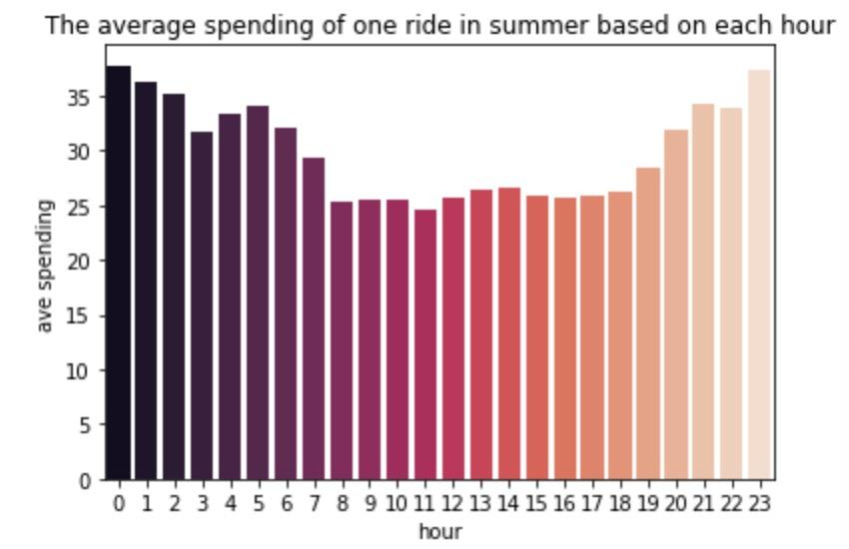
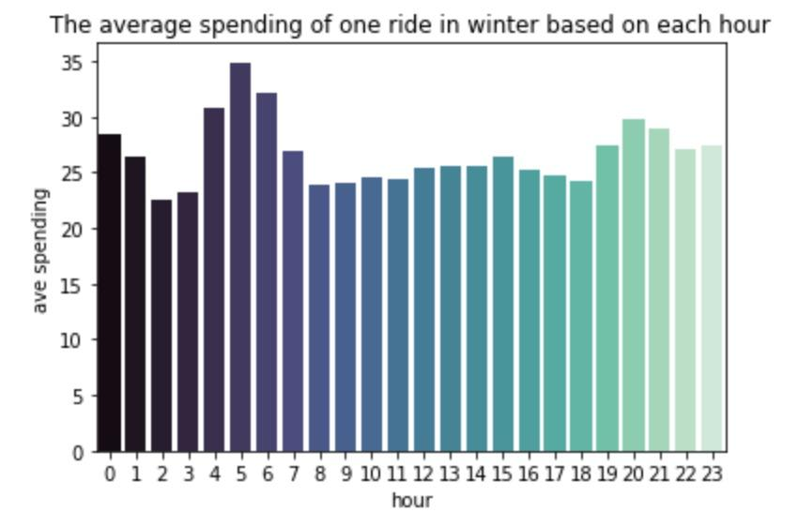
We further investigated the price distribution within a day, which is shown in this two panels. Interestingly, we found that the price peaks around 8am and 6pm, and people will pay more in the early morning in a winter day while pay more in the late night during summer.
Notes:
We further investigated the price distribution within a day, which is shown in this two panels. Interestingly, we found that the price peaks around 8am and 6pm, and people will pay more in the early morning in a winter day while pay more in the late night during summer.

Slide 12
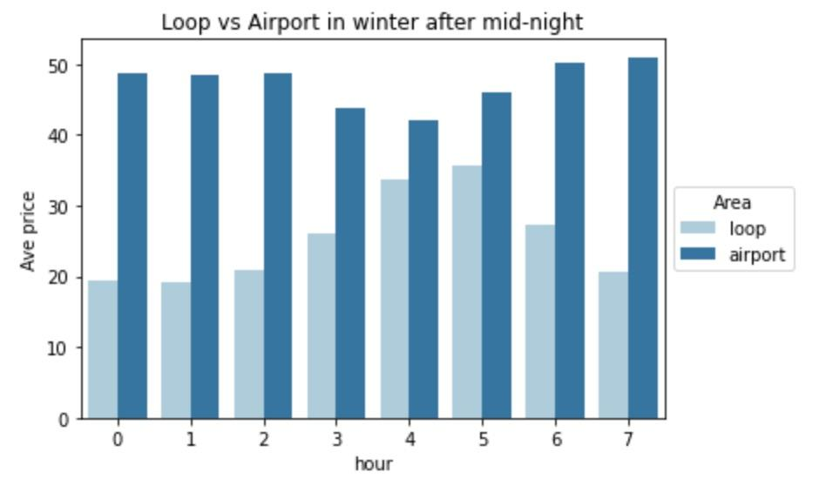
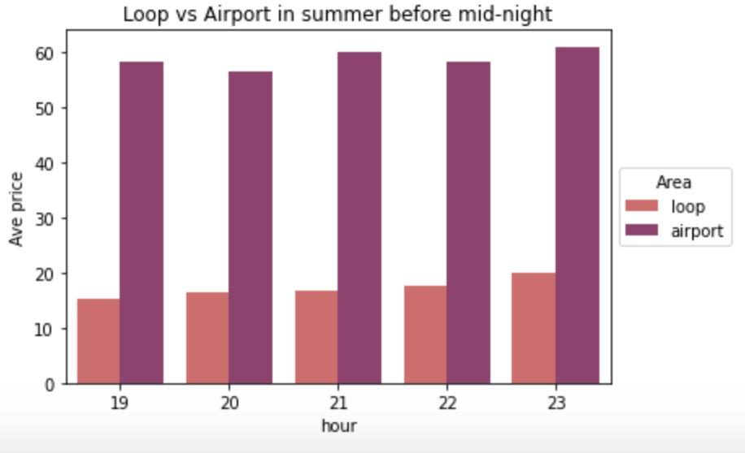
In this two panels, we can see that, thought the price is increasing during these two specific time periods, we can still tell that the most tremendous increase happened after the mid-night in the loop area and happened before the midnight in the airport area.
Notes:
In this two panels, we can see that, thought the price is increasing during these two specific time periods, we can still tell that the most tremendous increase happened after the mid-night in the loop area and happened before the midnight in the airport area.

Slide 13

Our goal in next step

Price prediction
How much will a person pay for his trip in one places to another of Chicago

Time spend prediction
How many time will a person spend when they start a taxi ride from one place to another

cheapest time prediction
Find the most recommendation time for a person to take a taxi
Notes:
Lastly, we make a plan for our next goal. Our next goal is to make Price prediction, time spend prediction and cheapest time prediction.

Slide 14
Thank you

